Slide 1
Intelligent Integrative Platform for Sharing Heterogenuous Stem Cell Research Data
Kirill Borziak, Irena Parvanova and Joseph Finkelstein
Icahn School of Medicine at Mount Sinai, New York, New York, USA

Slide 2
ReMeDy architecture
z
ReMeDy is an implementation of Signature Commons, a BD2K-LINCS platform implemented through Docker and designed to store and search diverse metadata in an agile and flexible manner.
ReMeDy is composed of six packages: proxy, ui, schema, metadata-api, controller, data-api
The ReMeDy platform uses a relational database for data storage. The leveraged data technology alongside a properly implemented schema for data storage provides strong data conformity to the FAIR guidelines (Findable, Accessible, Interoperable, and Reusable).
PostgreSQL
DB
ui
schema
proxy
metadata-api

Slide 3
ReMeDy data organization
Resource:
Master container for each published stem cell project
Contains libraries
Validator:
Quality control file
Used to verify formatting and requirements of JSON files, prior to ingestion
Allows for integration of ontology information
Applicable to resources, libraries and signatures
Library:
Container for project CDEs, e.g. Project, Manufacturing / Production, Outcomes Modules
Contains signatures
Schema:
Visualization control file
Defines how the data is presented in the search results
Applicable to resources, libraries and signatures
Signature:
Represents individual/ grouped Research System data
Contains information for patients, animal models, and in-vitro cell lines

Slide 4
Multi-modular CDE Framework
General Information
PI Information
Study Subject
Project
Regulatory
Compliance
Animal Model
Project Design
Source/Donor
Research
System
Stem Cell Characteristics
CDE
Modules
In-vitro System
Experimental Assay
Critical Process
Parameters
Critical Quality Attributes
Outcomes / Findings
In-depth Characterization
Primary Outcomes
Secondary
Outcomes
Experimental
Findings
Investigator Initiated Analyses
IDCCH Assays

Slide 5
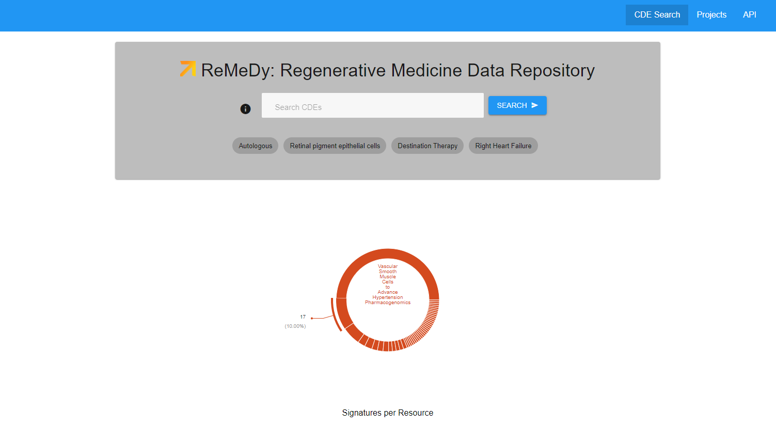
ReMeDy functionality

Slide 6
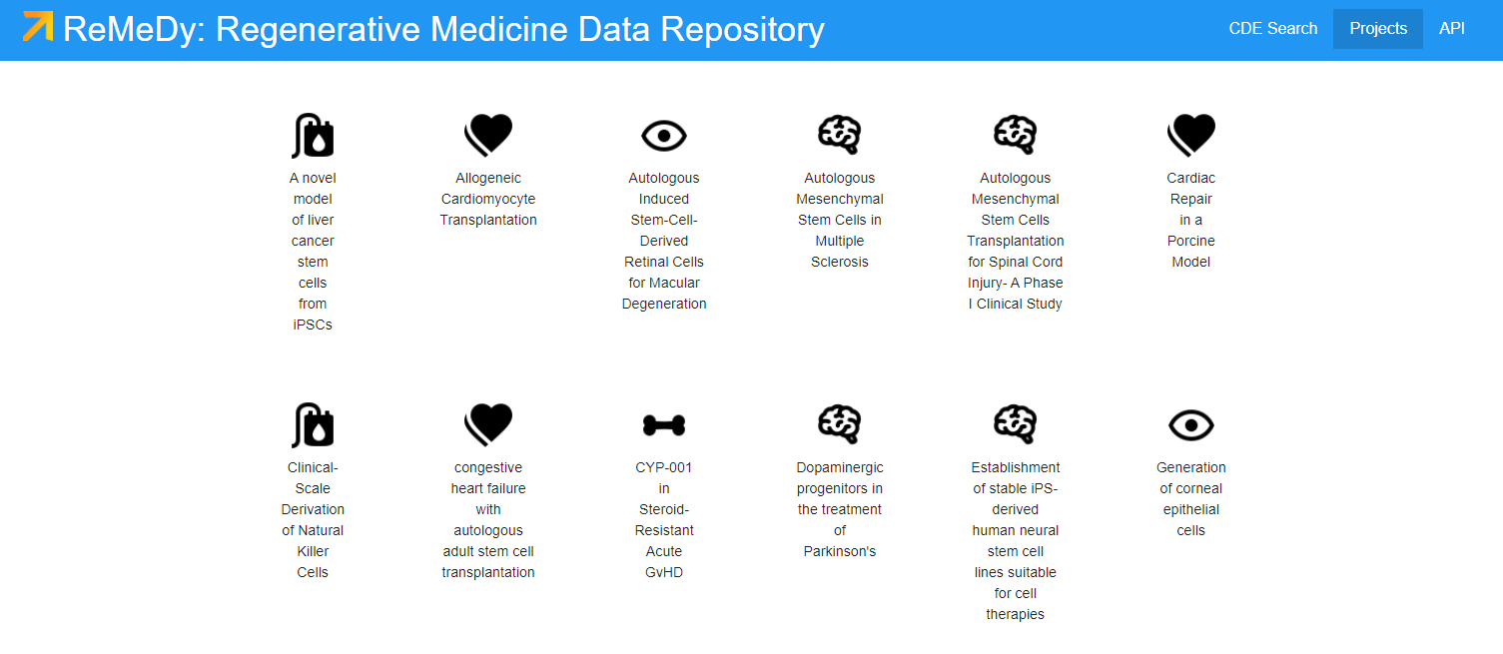
ReMeDy functionality
The individual project links provide access to all CDE content from each iPSC and CSC project in ReMeDy.

Slide 7
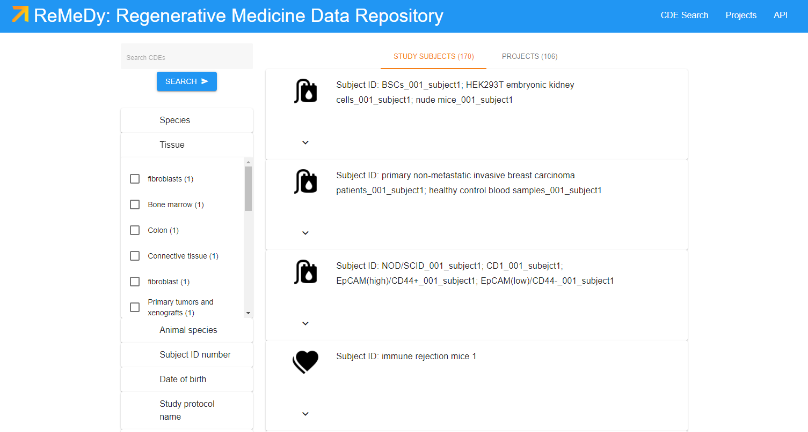
ReMeDy functionality
The customized counting schemas allow users access to quick CDE statistics and easy search refinement.

Slide 8
ReMeDy feasibility testing
To test the feasibility of the ReMeDy platform to successfully store data from stem cell projects, we abstracted CDEs fro 103 published clinical, pre-clinical, and in vitro induced pluripotent stem cell (iPSC) (51) and cancer stem cell (CSC) (52) studies.
The studies selection was randomized across PubMed indexed research, with the aim of obtaining a diverse set of research across time, research location, and research type.
Abstraction was performed by trained personnel with experience in stem cell research.
A total of 103 iPSC resources were created, along with 170 research subject records.
On average, 76 CDEs per iPSC study were abstracted out of a total of 841 CDEs in the multi-modular framework.

Slide 9
Distribution of stem cell projects in ReMeDy by project type

Slide 10
Geographical distribution of stem cell projects in ReMeDy

Slide 11
Distribution of stem cell projects in ReMeDy by primary disease

Slide 12
Thank you for your attention
https://remedy.mssm.edu/

