Slide 1
Utilizing Shared Big Data to Identify Liver Cancer Dedifferentiation Markers
Kirill Borziak and Joseph Finkelstein
Icahn School of Medicine at Mount Sinai

Slide 2
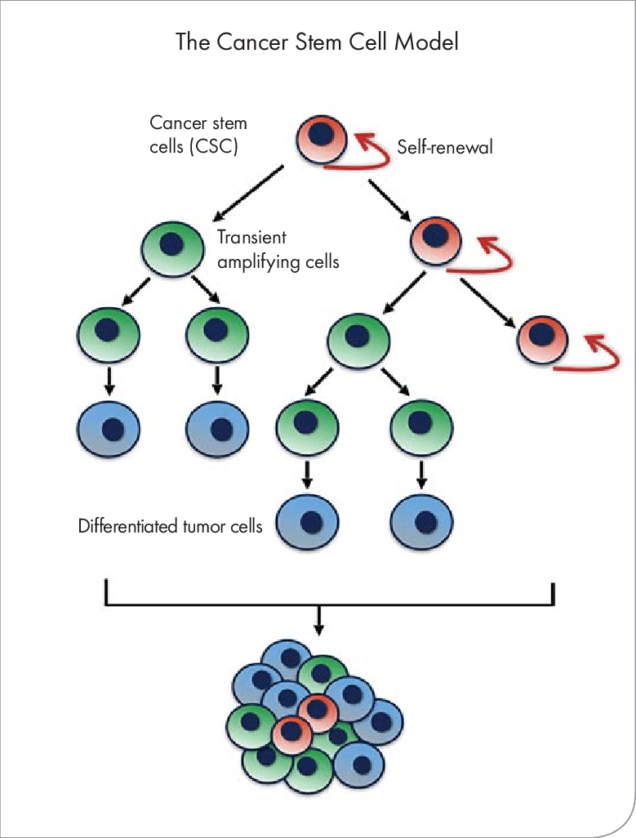
Cancer Stem Cells
Growing evidence has implicated cancer stem cells for causing the therapeutic resistance, tumor recurrence, and metastasis.
Cancer stem cells represent a key target for translational medicine in improving cancer treatment and outcomes.
It is still not entirely understood how cancer stem cells are derived from adult fully differentiated cells with regards to expression of dedifferentiation factors.
Here we present a meta analysis of adult liver and liver cancer single cell RNA-seq analyses.
Zhang, Kangyi. (2016). A Chemopreventive Nanodiamond Platform for Oral Cancer Treatment. Journal - California Dental Association. 44. 121-127.

Slide 3
Meta analysis
The following studies were utilized for liver cancer cell profiles (GSE125449) and healthy liver cell profiles (GSE130473).
The liver cancer study consists of 9946 single-cell RNA-seq profiles from 19 patients, totaling over 56 million reads and 4.2 billion base pairs.
The adult liver study consists of 1467 single-cell RNA-seq profiles, totaling 283 million reads and 21 billion base pairs.
We performed extensive pre-processing normalization, including filtering out low coverage samples (<1000 reads), low coverage genes (0 in all samples), and non-protein coding genes.
To control for batch effects between samples, we utilized EdgeR to control for library size, calculate the common dispersion for all genes, and individual gene dispersion.
Differential expression was assessed using the quasi-likelihood F-test after fitting the negative binomial GLM for each gene, using study type in the design matrix to further account for batch effect.
False discovery rate was controlled using Bonferroni multiple testing correction.

Slide 4
Differential expression
The final differential expression analysis consisted of 2434 single-cell samples across 18,263 protein-coding genes.
We compared expression of two types of adult liver cells (CD235a-/EpCAM+/ASGPR1+ and CD235a-/EpCAM+) (444 single-cell samples) and the liver CSCs (1990 single-cell samples).
We identified 519 genes that were differentially expressed between liver CSCs and adult liver cell types.
134 were significantly higher expressed in the liver CSCs.
385 protein coding genes were significantly higher expressed in the adult liver cell types.

Slide 5
Gene Ontology analysis
Gene categories enriched in liver CSCs
GO Term | GO ID | P-value
Structural constituent of ribosome | GO:0003735 | 8.9E-27
Translation initiation complex | GO:0070992 | 9.8E-24
rRNA processing | GO:0006364 | 1.1E-20
Mitochondrial respiratory chain complex I | GO:0005747 | 3.1E-5
NADH dehydrogenase (ubiquinone) activity | GO:0008137 | 3.2E-5
ATP biosynthetic process | GO:0006754 | 2.9E-3
Extracellular vesicle | GO:1903561 | 6.2E-12
ncRNA processing | GO:0034470 | 3.2E-14

Slide 6
Gene Ontology analysis
Gene categories enriched in adult liver cell types
GO Term | GO ID | P-value
organic acid metabolic process | GO:0006082 | 8.1E-18
carboxylic acid metabolic process | GO:0019752 | 1.2E-17
lipid metabolic process | GO:0006629 | 4.3E-7
drug metabolic process | GO:0006805 | 5.4E-5

Slide 7
Dedifferentiation factors
Factor | Gene ID | Fold change | P-value
Hepatocyte Nuclear Factor 4 Alpha | HNF4A | 0.338X | 4.43E-5
Transforming Growth Factor β1 | TGFB1 | 4.74X | 1.46E-104
Msh Homeobox 2 | MSX-2 | 1.36X | 1.99E-17
HNF4A, the primary differentiation factor of liver cells, is significant downregulated in liver CSCs.
TGFB1, driver of mesenchymal/stemness phenotype observed in hepatocellular carcinomas, is significantly upregulated in liver CSCs.
Although Msx1 has been implicated in intestinal tumorigenesis, we report MSX-2 as a potential novel dedifferentiation factor involved in liver carcinoma development.

Slide 8
Thank you for your attention

