Slide 1
Using EHR Data to Identify Social Determinants of Health Affecting Disparities in Cancer Survival
Wanting Cui
Joseph Finkelstein

Slide 2
Objectives

Slide 3
Introduction

Slide 4
Dataset
A limited dataset was generated from electronic medical records from Mount Sinai Health System
Time period: 2003/01/01 – 2019/12/31
Cancer types:
Breast Cancer
Colorectal Cancer
Lung Cancer
Multiple myeloma
Prostate Cancer
Exclusion criteria:
Children (less than 18 years old at diagnosis)
Patients with missing values

Slide 5
Subsets and Variables
We extract 2 subsets:
Short term survival: Patients who survived less than a year between diagnosis and death
Long term survival: Patients who survived 5 year or more after diagnosis
Currently alive: patients’ diagnoses date prior to 2015/1/1
Currently deceased: number of days between diagnoses and death are greater than 1825 days
Variables:
Age
young adults: 18 – 40 years old
Middle age adults: 41 – 65 years old
Older adults: 66 and 66+ years old
Sex, race, alive indicator, cancer diagnoses date and death date

Slide 6
Statistical Methods
Exploratory data analysis
Logistic Regression
the effect of demographical factors on patients duration of survival after cancer diagnosis
Independent variables: age, sex and race
Dependent variables: short term survival (1), long term survival (0)

Slide 7
Results (EDA)
There are 22,096 patients in the dataset
 | Short Term Survival |  | Long Term Survival |  | Overall
Cancer Type | Count | Percent | Count | Percent | Count | Percent
Breast | 78 | 6.09% | 6390 | 30.70% | 6468 | 29.27%
Colorectal | 292 | 22.81% | 3613 | 17.36% | 3905 | 17.67%
Lung | 757 | 59.14% | 2064 | 9.92% | 2821 | 12.77%
Multiple Myeloma | 92 | 7.19% | 2017 | 9.69% | 2109 | 9.54%
Prostate | 61 | 4.77% | 6732 | 32.34% | 6793 | 30.74%
 | 1280 |  | 20816 |  | 22096

Slide 8
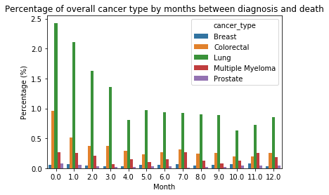
Results (EDA)
There are significantly more lung and colorectal cancer patients survived a short period of time
There are significantly less breast and prostate cancer patients survived a short period of time
The MM

Slide 9
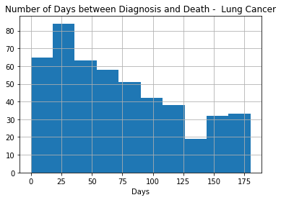
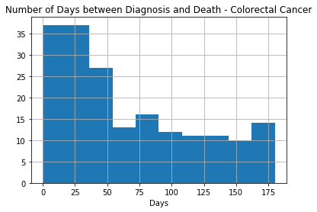
Results (EDA)

Slide 10
Cancer Type | Lung |  | Colorectal |  | Breast |  | MM |  | Prostate
Survival Period | Short | Long | Short | Long | Short | Long | Short | Long | Short | Long
Count | 757 | 2064 | 292 | 3613 | 78 | 6390 | 92 | 2017 | 61 | 6732
Age
mean | 69.84 | 67.23 | 71.74 | 62.41 | 71.38 | 56.38 | 67.93 | 59.38 | 73.48 | 62.27
std | 11.16 | 11.05 | 15.04 | 13.84 | 15.71 | 12.98 | 12.34 | 10.95 | 10.62 | 8.40
median | 70 | 68 | 74 | 62 | 70.5 | 56 | 67 | 60 | 73 | 62
Age group
Young Adult | 0.53% | 1.50% | 3.08% | 5.90% | 0.00% | 10.03% | 2.17% | 4.71% | 0.00% | 0.30%
Middle Age Adult | 33.29% | 40.16% | 27.40% | 52.53% | 37.18% | 65.49% | 42.39% | 66.44% | 22.95% | 64.97%
Older Adult | 66.18% | 58.33% | 69.52% | 41.57% | 62.82% | 24.48% | 55.43% | 28.85% | 77.05% | 34.73%

Slide 11
Gender
Female | 44.65% | 57.22% | 44.52% | 49.82% | 100.00% | 99.33% | 40.22% | 45.51% | 0.00% | 0.00%
Male | 55.35% | 42.78% | 55.48% | 50.18% | 0.00% | 0.67% | 59.78% | 54.49% | 100.00% | 100.00%
Race
American Indian | 0.26% | 0.10% | 0.00% | 0.08% | 0.00% | 0.09% | 0.00% | 0.10% | 0.00% | 0.07%
Asian | 0.66% | 1.70% | 1.71% | 2.82% | 0.00% | 3.97% | 0.00% | 1.54% | 0.00% | 0.86%
Black | 23.25% | 12.06% | 17.47% | 13.01% | 34.62% | 13.97% | 27.17% | 16.86% | 24.59% | 15.21%
Islander | 4.49% | 3.68% | 8.22% | 7.61% | 1.28% | 1.61% | 3.26% | 1.04% | 0.00% | 0.94%
Other | 16.38% | 11.68% | 14.73% | 14.89% | 28.21% | 20.22% | 20.65% | 27.17% | 16.39% | 15.08%
White | 54.95% | 70.78% | 57.88% | 61.58% | 35.90% | 60.13% | 48.91% | 53.30% | 59.02% | 67.84%

