Slide 1

Cognitive Testing of an Electronic Consent Platform: Researcher Perspectives
Nursing Informatics International Congress 2021
Irena Parvanova, PhD; Daniel Robins, MD; Joseph Finkelstein MD, PhD

Slide 2
Introduction
The E-Consent platform is a flexible framework designed to accommodate a wide variety of research consent workflows using electronic devices.
The platform has experienced multiple iterations, based on several prior usability studies and lessons learned from working with a wide variety of potential users.
After many cycles of improvement focusing on end-users, the platform has now matured into a new version.
Previous usability studies collected feedback primarily from patients using the platform. The Aim of this study was to gather input from research staff to further improve the system performance.

Slide 3
Methods: System Design
Electronic Consent Platform
Education Module:
-Study-relevant background information to assist users as they make an informed choice about consenting to a research study.
- The module is divided into ‘chapters’, organized around a main menu that acts like a table of contents.
Consent Module:
- Delivers the content of the informed consent form.
- The module is divided into ‘chapters’, organized around the content of the consent form.

Slide 4
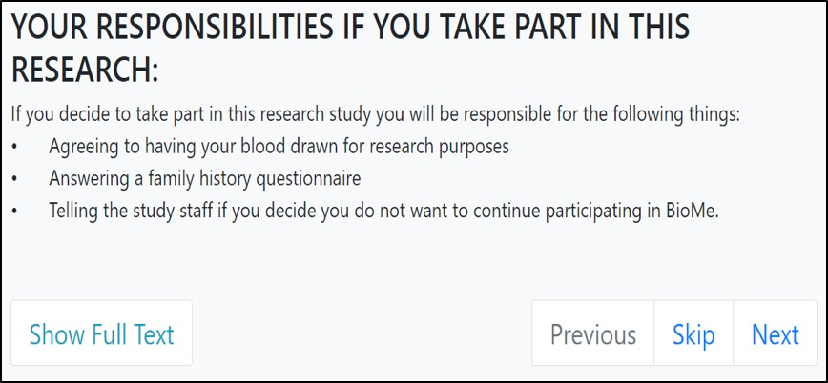
Methods: System Design
Within each chapter, information is presented as paraphrased ‘tips’.

Slide 5
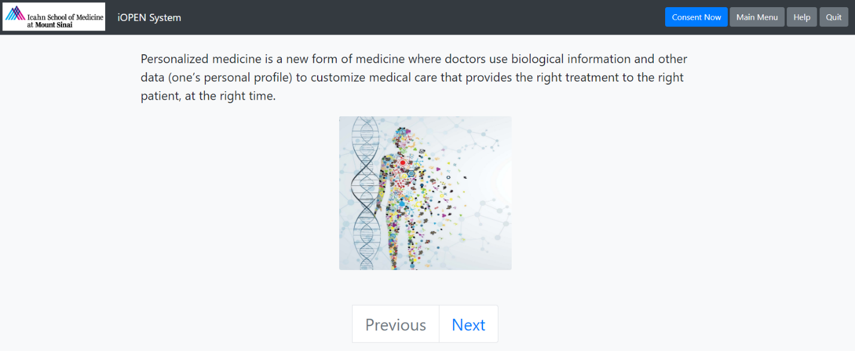
Methods: System Design
Short multiple-choice quizzes based on the content of tips appear periodically. A correct answer to progress to the next page.
The interface is consistent to the approved consent form. Content is again paraphrased into smaller tips that may or may not include multimedia.
The Consent Module concludes by showing the full text of the consent form one final time, followed by an electronic signature page.

Slide 6
Methods: Study Design
Participants were given a packet of instructions and surveys upon sitting down at a workstation.
Surveys consisted of standardized questions with answers arranged as Likert-type scales and written responses.
A baseline questionnaire was collected immediately, and the starting website was already displayed on the web browser.
Participants were instructed to perform three representative tasks while being timed. If additional help is needed to complete a task, these requests were also noted.

Slide 7
Task 1: Progress through Educational Module
Methods: Study Design
Task 2: Progress through Consent Module and Sign Consent Form
Task 3: Complete System Usability Scale Survey
Post Task surveys asked participants to rank each task on a Likert-like scale of 1 (very difficult) to 5 (very easy)!

Slide 8
Results: Task Self-Assessment
1 (very difficult) to 5 (very easy)

Slide 9
Results: Heuristics Evaluation Means

Slide 10
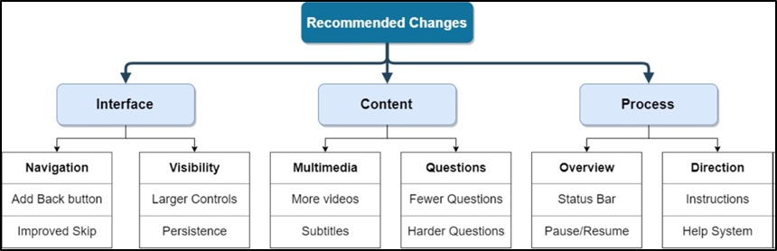
Results: Usability Concept Map of experts' suggestions

Slide 11
Discussion
Feedback from the research staff cohort yielded multiple actionable points.
Experts offered useful information about usability in a number of cases, such as the need for optimized font size, color, emphasis, subtitles, and controls.
Regarding the traditional paper workflow for consents, the experts generally agree that this electronic system is preferable.
Limitations of this study are related to the target user group. This expert subset is already familiar with informed consent procedures, and they have a high self-reported English and medical literacy.
Regardless, the experts provided valuable insight into the research workflows that resulted in a series of modifications to the platform.

Slide 12
Conclusion
Expert review represents a valuable source of feedback for development, beginning with the formative usability evaluation and recurring with later product refinement.
The group of experts provided multiple actionable points that will be incorporated in the next development cycle.

Slide 13
Thank you!
Questions?

