Slide 1
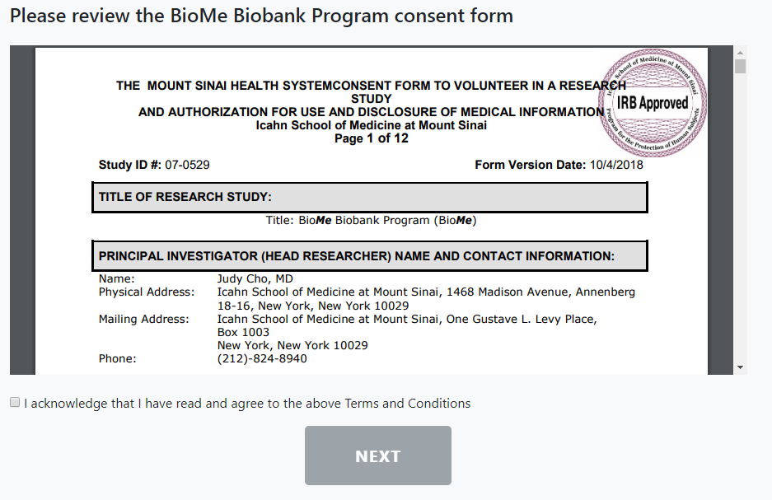
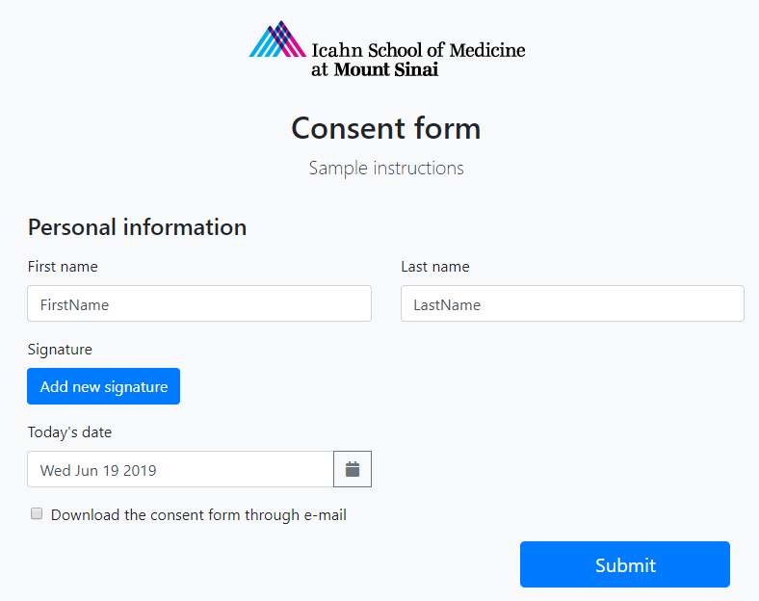
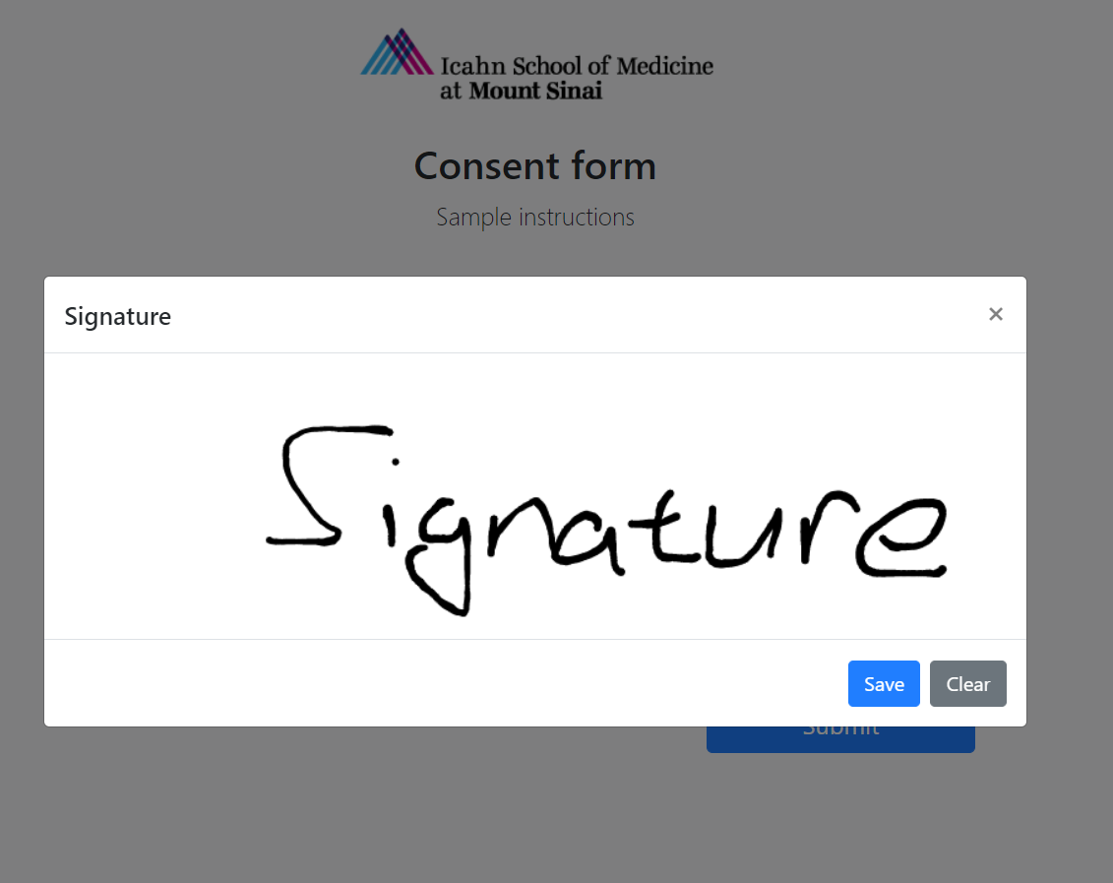
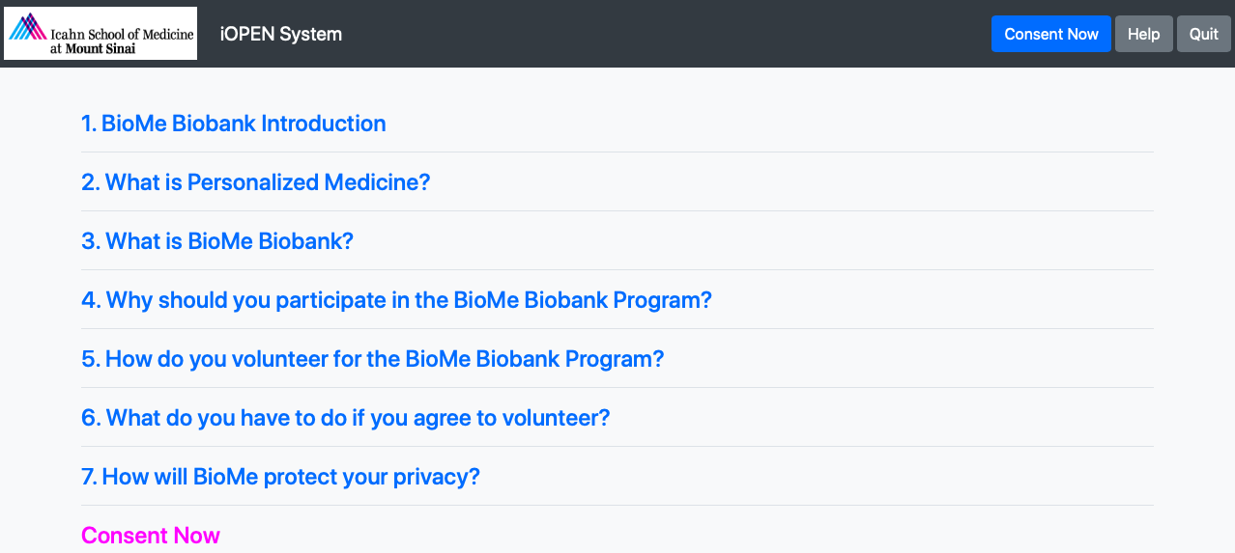
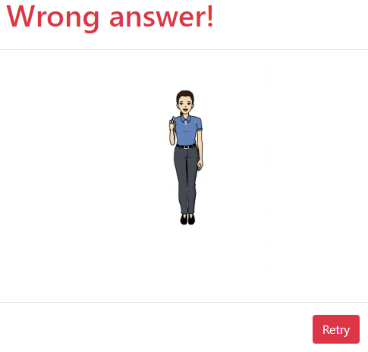
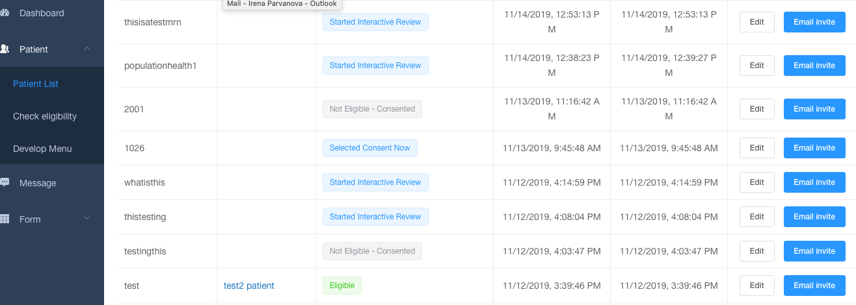
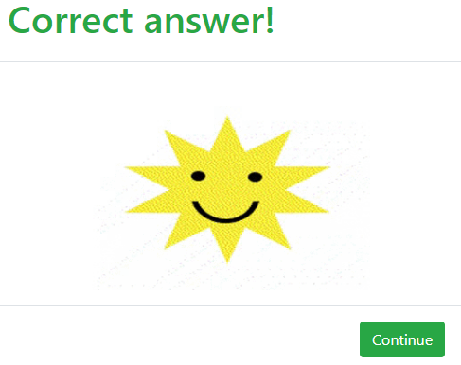
Overview of Multipurpose Universal Informed Consent Platform
Irena PARVANOVA, Ph.D., Daniel ROBINS, MD, Jiazhen LIU, MS,
and Joseph FINKELSTEIN, MD, Ph.D.
Population Health Science and Policy Department, ISMMS
BACKGROUND
E-consent outline
Conclusions
Informed Consent
Is required by the International Council for Harmonization for Good Clinical Practice (ICH GCP)
Goes beyond a signed form
Involves educational process: starts by informing a potential study subject and continues throughout the study
Requires disclosure of information, comprehension, and a voluntary participation
May become complex and challenging to understand
May be part of programs, requiring consenting of a large number of people
Electronic Informed Consent
Electronic consent is increasingly used as means to facilitate patient engagement in clinical research
Current electronic consent platforms usually support a single research protocol or a particular clinical trial
Multipurpose Universal Electronic Informed Consent
The platform allows researchers to easily upload multimedia information about a particular research protocol along with an approved informed consent into the Mount Sinai system
The system executes this content interactively for prospective study candidates in a user-friendly way
R.E. Mayer, Multimedia Learning, Cambridge University Press, New York, 2001
The long and complex educational information is divided into smaller “chapters”, accessible through a central menu.
The interactive menu acts as a table-of-contents, where each chapter is linked to a video featuring a person that explains the section in layman terms.
Following the brief video, a short paragraph of text reiterates the content of that chapter.
The usability inspection of the electronic consent platform demonstrated overall high acceptance of the E-Consent interface even by naive users.
Our results corroborated previous reports of positive feedback of prospective research participants regarding various tools supporting informed consent via interactive media.
(B)
(A)
(C)
Figure 2. Consent Module: (A) Full-length consent form; (B) Personal information to be entered; (C) Enter and submit signature.
Clinical significance
Open-ended comments provided by the participants demonstrated that they perceived electronic consenting to be overall: - easy-to-use, - explains complex matters and forces understanding, - timely in comparison to printout version, while delivering complex information such as that on a consent form.
Enrollment and monitoring of clinical studies involving a large number of patients (the process is extended throughout the study).
METHODS
(A)
Workflow of Patient Participation in BioMe E-Consent Evaluation:
1) Participants are given a packet of instructions and surveys upon sitting down at a workstation.
2) Surveys consisted of standardized questions with answers are arranged as Likert-type scales and written responses.
3) A baseline questionnaire is collected immediately, and the starting website was already displayed on the web browser.
4) Participants are instructed to perform three representative tasks while being timed. If additional help is needed to complete a task, these requests were also noted.
3 Tasks for Patients to Accomplish:
Education Task in Educational Module:
38sec educational video is followed by selecting a correct answer in a series of multiple choice questions.
2) Consenting Task
Entering a name and adding a signature, followed by submitting a signature within the Consent Module.
3) Taking a survey questionnaire.
(A)
48 participants
Both males and females
Ages 23-84
Diverse background
(B)
(C)
Acknowledgements
(B)
Figure 3. (A) Dashboard monitoring the number of patients, their availabilities, and the existence of messages. (B) Dashboard monitoring of patients availability and progress through the consent process. (C) Number of patient who tested the E-Consent platform.
Figure 1. Educational Module: (A) Interactive menu and (B) Multiple choice questions with a correct and wrong answer options.
References
NIH R01 MH109544
NIH R01 CA202911-01A1
NARSAD Young Investigator Grant
Icahn School of Medicine Capital Campaign, Translational and Molecular Imaging Institute and Department of Radiology
CCNY Department of Biomedical Engineering

