Slide 1
Comparison of ACM and CLAMP for Entity Extraction in Clinical Notes
Fatemeh Shah-Mohammadi, Wanting Cui, Joseph Finkelstein
Center for Biomedical and Population Health Informatics, Icahn School of Medicine at Mount Sinai, New York, NY.

Slide 2
Overview
Why is Entity Extraction needed?
Clinical Entity Extraction Tools:
Clinical Language Annotation, Modeling and Processing (CLAMP)
Amazon Comprehend Medical (ACM)
Dataset
Evaluation Metrics
Results & Discussion
Conclusion

Slide 3
Why is Entity Extraction needed?
Clinical Notes recorded in unstructured format
Clinical Notes contain vast amount of information
Information needs to be extracted for further utilization and analysis in daily healthcare setting
Extracted information also form basis for other tasks (disease correlation and classification)
Roque FS, et al. Using electronic patient records to discover disease correlations and stratify patient cohorts. PLoS Comput Biol. 2011 Aug 25;7(8):e1002141.
Yildirim P, Çeken Ç, Hassanpour R, Tolun MR. Prediction of similarities among rheumatic diseases. J Med Syst. 2012; 36(3):1485–90

Slide 4
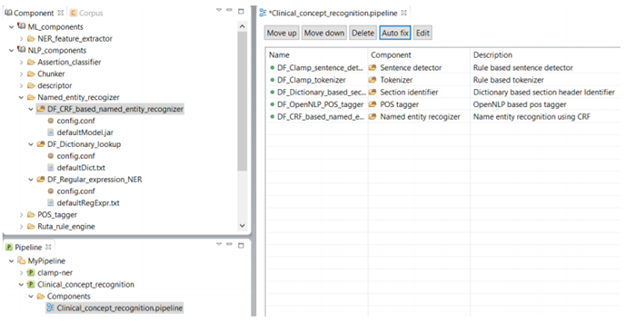
Tools: Clinical language annotation, modeling and processing tool (CLAMP)
NLP-based clinical entity extraction tool
Developed by: University of Texas, Health Science Center at Houston
Provides interactive development environment (IDE) for building customized clinical NLP solutions
Presents a pipeline-based architecture that builds NLP systems from multiple components
Soysal, Ergin, et al., “CLAMP–a toolkit for efficiently building customized clinical natural language processing pipelines,” Journal of the American Medical Informatics Association 25.3, pp: 331-336, 2018.
CLAMP | Natural Language Processing (NLP) Software (uth.edu)

Slide 5
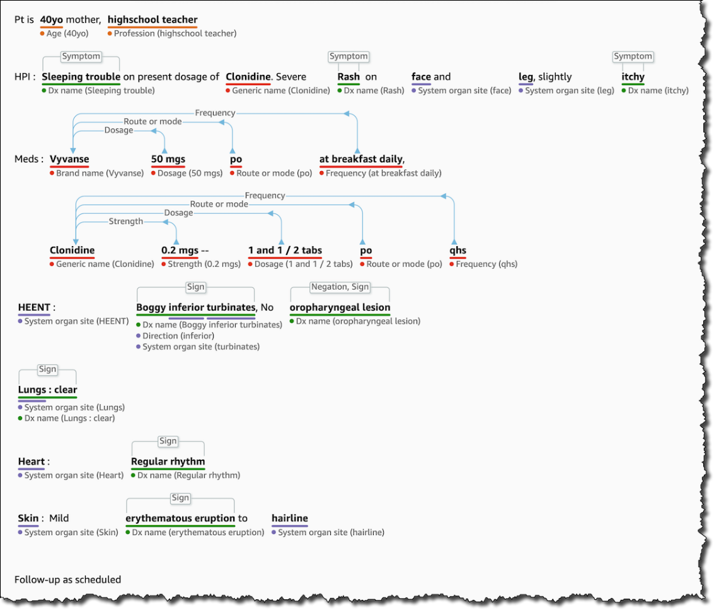
Tools: Amazon Comprehend Medical (ACM)
A deep neural network-based entity extraction tool
Developed by Amazon Web Service (AWS)
Uses deep learning based system (Long Short Term Memory (LSTM) network and Transfer Learning)
P. Bhatia, B. Celikkaya, M. Khalilia and S. Senthivel. Comprehend Medical: A Named Entity Recognition and Relationship Extraction Web Service, 18th IEEE ICMLA. 2019;1844-1851
https://aws.amazon.com/blogs/aws/new-amazon-comprehend-medical-adds-ontology-linking/

Slide 6
Dataset
The 2014 i2b2 heart disease and its associated risk factors identification dataset
Consists of 521 medical records with distribution of 8 disease risk factor categories and 38 associated indicators
Category
Hypertension
Hyperlipidemia
Diabetes
Obese
Coronary Artery Disease (CAD)
Medication
Family History
Smoking Status
Indicator
Hyperlipidemia
Dyslipidemia
Hypercholesterolemia
High Cholesterol

Slide 7
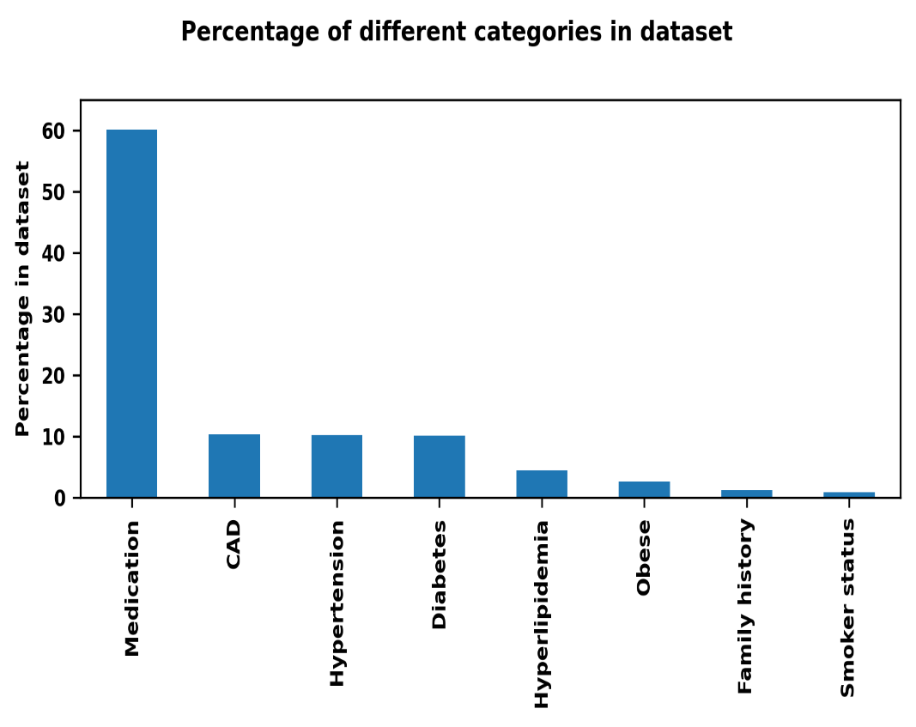
Dataset
Both IE systems link their extracted entities to normalized concept identifiers from the RxNorm database.
RxNorm provides normalized names and unique identifiers only for medicines and drugs.
Amongst 8 categories, we only considered entities categorized as “medication”.
Entities tagged as “medication” account for around 60% of the annotations.

Slide 8
Evaluation Metrics
Expert annotation considered as a gold standard for evaluation
Data cleaning pipeline:
Records in XML format
Separated actual narrative text from the annotations
Imported annotations into a relational database
Evaluation metrics: Recall, Precision, and F-score
id | start | end | text | tag
M0 | 1339 | 1346 | ZESTRIL | MEDICATION
M3 | 1400 | 1407 | LIPITOR | MEDICATION
M6 | 1272 | 1275 | ASA | MEDICATION
M9 | 1174 | 1180 | ATENOLOL | MEDICATION

Slide 9
Results & Discussion
20 entities has been selected for comparison
Entities annotated by experts | Frequency of occurrences | CLAMP |  |  | ACM
 | (sample size equals 1251 ) | Recall | Precision | F_score | Recall | Precision | F_score
Atenolol | 211 | 1 | 0.91 | 0.95 | 1 | 0.93 | 0.96
Norvasc | 60 | 0.80 | 1 | 0.89 | 1 | 0.90 | 0.95
Lipitor | 185 | 1 | 0.99 | 0.99 | 1 | 0.84 | 0.91
Aspirin | 195 | 0.99 | 1 | 0.99 | 1 | 0.94 | 0.97
Metoprolol | 69 | 0.72 | 1 | 0.84 | 0.67 | 1 | 0.80
Glucophage | 60 | 0.85 | 1 | 0.92 | 1 | 1 | 1
Toprol | 36 | 0.50 | 1 | 0.67 | 0.50 | 1 | 0.67
Lisinopril | 225 | 1 | 0.89 | 0.94 | 1 | 0.86 | 0.92
Pravachol | 23 | 1 | 0.92 | 0.96 | 0.39 | 1 | 0.56
Zocor | 34 | 0.82 | 1 | 0.9 | 1 | 0.83 | 0.91
Nifedipine | 23 | 0.91 | 1 | 0.95 | 0.83 | 1 | 0.91
Zestril | 53 | 0.96 | 1 | 0.98 | 1 | 0.81 | 0.89
Lovastatin | 4 | 1 | 1 | 1 | 1 | 1 | 1
Pravastatin | 34 | 0.82 | 1 | 0.90 | 1 | 0.92 | 0.96
Isosorbide | 7 | 1 | 0.88 | 0.94 | 1 | 0.88 | 0.94
Labetolol | 8 | 1 | 0.80 | 0.89 | 1 | 0.80 | 0.89
Zebeta | 2 | 1 | 1 | 1 | 1 | 1 | 1
Coreg | 7 | 0.86 | 1 | 0.92 | 0.86 | 1 | 0.92
Accupril | 3 | 0.33 | 1 | 0.50 | 0.33 | 1 | 0.50
Glucotrol | 12 | 1 | 1 | 1 | 0.67 | 1 | 0.80
Average |  | 0.88 | 0.90 | 0.91 | 0.86 | 0.94 | 0.87

Slide 10
Results & Discussion
Entities annotated by experts | Frequency of occurrences | CLAMP |  |  | ACM
 | (sample size equals 1251 ) | Recall | Precision | F_score | Recall | Precision | F_score
Atenolol | 211 | 1 | 0.91 | 0.95 | 1 | 0.93 | 0.96
Norvasc | 60 | 0.80 | 1 | 0.89 | 1 | 0.90 | 0.95
Lipitor | 185 | 1 | 0.99 | 0.99 | 1 | 0.84 | 0.91
Aspirin | 195 | 0.99 | 1 | 0.99 | 1 | 0.94 | 0.97
Metoprolol | 69 | 0.72 | 1 | 0.84 | 0.67 | 1 | 0.80
Glucophage | 60 | 0.85 | 1 | 0.92 | 1 | 1 | 1
Toprol | 36 | 0.50 | 1 | 0.67 | 0.50 | 1 | 0.67
Lisinopril | 225 | 1 | 0.89 | 0.94 | 1 | 0.86 | 0.92
Pravachol | 23 | 1 | 0.92 | 0.96 | 0.39 | 1 | 0.56
Zocor | 34 | 0.82 | 1 | 0.9 | 1 | 0.83 | 0.91
Nifedipine | 23 | 0.91 | 1 | 0.95 | 0.83 | 1 | 0.91
Zestril | 53 | 0.96 | 1 | 0.98 | 1 | 0.81 | 0.89
Lovastatin | 4 | 1 | 1 | 1 | 1 | 1 | 1
Pravastatin | 34 | 0.82 | 1 | 0.90 | 1 | 0.92 | 0.96
Isosorbide | 7 | 1 | 0.88 | 0.94 | 1 | 0.88 | 0.94
Labetolol | 8 | 1 | 0.80 | 0.89 | 1 | 0.80 | 0.89
Zebeta | 2 | 1 | 1 | 1 | 1 | 1 | 1
Coreg | 7 | 0.86 | 1 | 0.92 | 0.86 | 1 | 0.92
Accupril | 3 | 0.33 | 1 | 0.50 | 0.33 | 1 | 0.50
Glucotrol | 12 | 1 | 1 | 1 | 0.67 | 1 | 0.80
Average |  | 0.88 | 0.90 | 0.91 | 0.86 | 0.94 | 0.87
In comparison with ACM, CLAMP showed better performance by around 2% for the average recall and 4.6% for the average F-score.

Slide 11
Results & Discussion
Entities annotated by experts | Frequency of occurrences | CLAMP |  |  | ACM
 | (sample size equals 1251 ) | Recall | Precision | F_score | Recall | Precision | F_score
Atenolol | 211 | 1 | 0.91 | 0.95 | 1 | 0.93 | 0.96
Aspirin | 195 | 0.99 | 1 | 0.99 | 1 | 0.94 | 0.97
Lisinopril | 225 | 1 | 0.89 | 0.94 | 1 | 0.86 | 0.92
Lovastatin | 4 | 1 | 1 | 1 | 1 | 1 | 1
Zebeta | 2 | 1 | 1 | 1 | 1 | 1 | 1
Accupril | 3 | 0.33 | 1 | 0.50 | 0.33 | 1 | 0.50
Amongst the three least frequent entities, both tools were able to perfectly identify two of them.
For three most frequent entities, Average recall for CLAMP: 0.997, for ACM: 1.
ACM performs better in identifying the most frequent entities.

Slide 12
Conclusion
Need for automated entity extraction tools
Two such tools: CLAMP and Amazon Comprehend Medical (one is general purpose)
CLAMP showed better performance by around 2% for the average recall and 4.6% for the average F-score, in comparison with ACM.
In the future: evaluate performance in extracting entities belonged to the other remaining categories.

Slide 13
Thank you

