Slide 1
Characteristics of Electronic Informed Consent Platforms for Consenting Patients to Research Studies: A Scoping Review
Jennifer Guarino, Irena Parvanova, Joseph Finkelstein
Center for Biomedical and Population Health Informatics,
Icahn School of Medicine at Mount Sinai, New York, NY, USA

Slide 2
Introduction
Informed consent ensures that research study participants are competent and adequately
informed
Electronic informed consent (eIC) for research studies and surgical procedures
Investigating consent metrics such as usability, satisfaction, enjoyment, accessibility,
enrollment, trust, time, and capacity of participants
We conducted a scoping review with three main objectives:
to describe the technological features of current electronic consent platforms,
to summarize the usability and efficacy of these platforms in consenting patients
to identify areas for future research regarding electronic consent

Slide 3
Methods
Search Strategy:
We used the following search terms: (("electronic consent") OR ("e-consent") OR ("econsent") OR ("eIC"))
AND ("Informed Consent") AND (English[lang))
Study Strategy
studies discussing an eConsent platform or multimedia educational module
studies including a description of the features or interface of the eConsent platform
studies including either a usability or efficacy evaluation of the platform
Data Extraction
First author
Year of publication
Sample size
Study location
Research procedure
Methodology

Slide 4
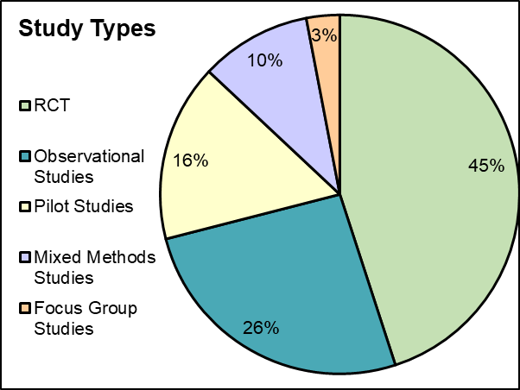
Results: Distribution of study types

Slide 5
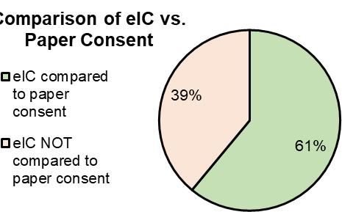
Results: Comparison of eIC and paper consent

Slide 6
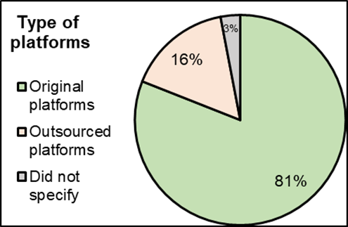
Results: Type of platforms

Slide 7
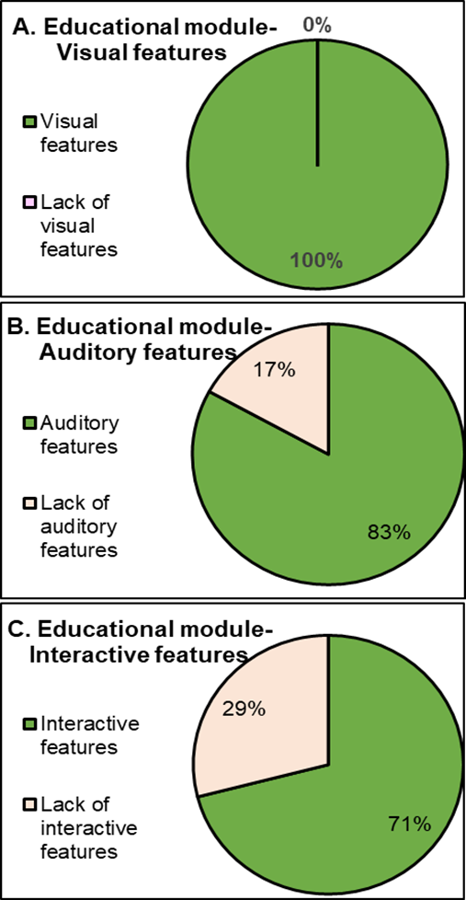
Results: Type of educational modules in econsent platforms

Slide 8
Results: Metrics of electronic consents
 | # Studies | Percentages (%)
Usability
Assessed | 15 | 48
Not | 16 | 52
Satisfaction
Assessed | 14 | 45
Not | 17 | 55
Preference
Assessed | 13 | 42
Not | 18 | 58
Accessibility
Assessed | 12 | 39
Not | 19 | 61
Enrollment
Assessed | 2 | 6
Not | 29 | 94
Knowledge
Assessed | 24 | 77
Not | 7 | 23
Trust
Assessed | 9 | 29
Not | 22 | 71
Time to Consent
Assessed | 14 | 45
Not | 17 | 55
Capacity to Consent
Assessed | 4 | 13
Not | 27 | 87

Slide 9
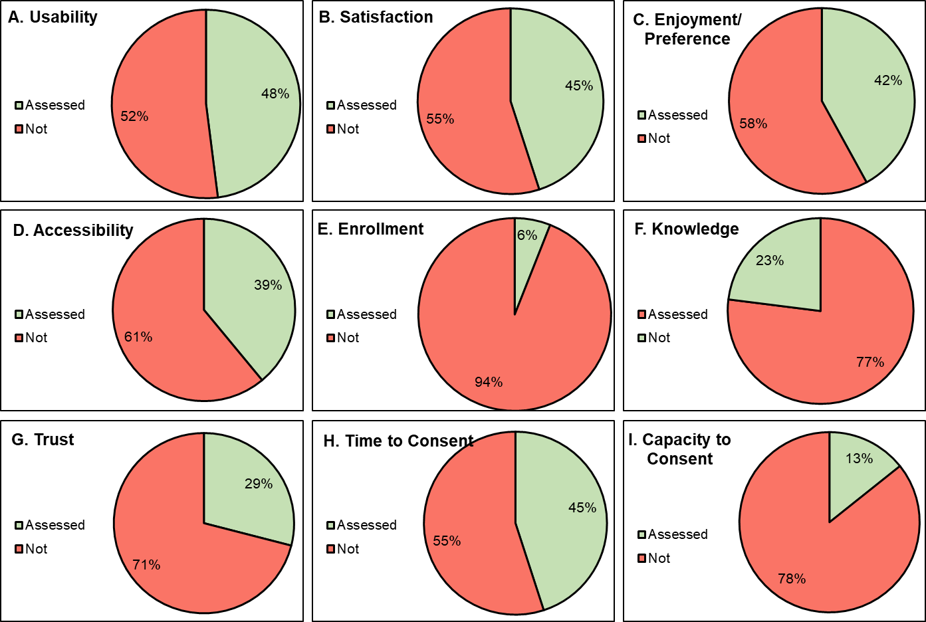
Results: Metrics of electronic consents

Slide 10
Discussion

Slide 11
Conclusion

Slide 12
Thank you!
Questions?

