Slide 1
A Platform for Integrating and Sharing Cancer Stem Cell Data
Irena Parvanova PhD, Kirill Borziak PhD, Jennifer Guarino, Joseph Finkelstein MD, PhD
October 8, 2021

Slide 2
ReMeDy Framework​ and Aims
ReMeDy platform is based on Signature Commons framework
Signature Commons was designed as a part of the BD2K-LINCS DCIC effort
Common Data Elements (CDE) are uploaded using JSON format and validated against existing ontologies
ReMeDy is designed to contain regenerative medicine projects data, including stem cell characteristics, study subject baseline and outcome information, and links to omics data files
ReMeDy aims to facilitate cancer care innovation by providing an integrated source of information for cancer stem cell studies

Slide 3
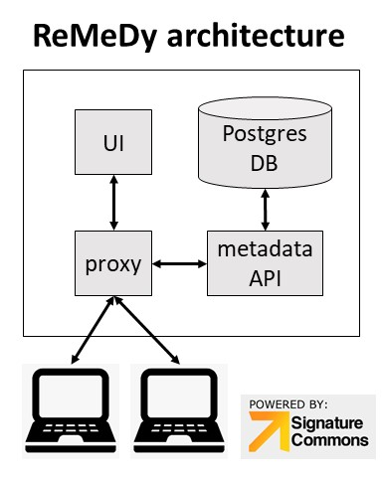
Visual Representation of the ReMeDy Architecture: Interaction between the Docker Containers
D.J.B. Clarke et al, “Signature Commons: A Scalable Platform for Serving Diverse Biomedical Data,” Submitted for publication.
K. Borziak, T. Qi, J. E. Evangelista, D. J. B. Clarke, A. Ma'ayan, and J. Finkelstein, "Towards Intelligent Integration and Sharing of Stem Cell Research Data," Stud Health Technol Inform, vol. 272, pp. 334, 2020.

Slide 4
Multi-modular CDE Framework diagram
General Information
PI Information
Study Subject
Project
Source/Donor
Project Design
Regulatory Compliance
Research
Subjects
Manufacturing / Production
CDE
Modules
In-vitro System
Animal Model
Critical Process
Parameters
Critical Quality Attributes
Outcomes / Findings
In-depth Product Characterization
Primary Clinical Outcomes
Secondary Clinical
Outcomes
Preclinical and
In Vitro
Findings
Investigation Initiated Product Analysis
IDCCH Assays
J. Finkelstein, I. Parvanova, and F. Zhang, "Informatics Approaches for Harmonized Intelligent Integration of Stem Cell Research," Stem Cells Cloning, vol. 13, pp. 1-20, 2020.

Slide 5
Introduction
Cancer stem cells (CSCs) are associated with resistance of tumors to treatments and formation of metastasis in multiple cancers
There is a lack of CSC data homogeneity, organization, deposition, and visualization
ReMeDy repository allows for the systematical collection and sharing of data
The functionality and usability of the platform was tested by uploading 52 multi-modal CDE templates, based on 52 published CSC clinical, pre-clinical, and in vitro studies

Slide 6
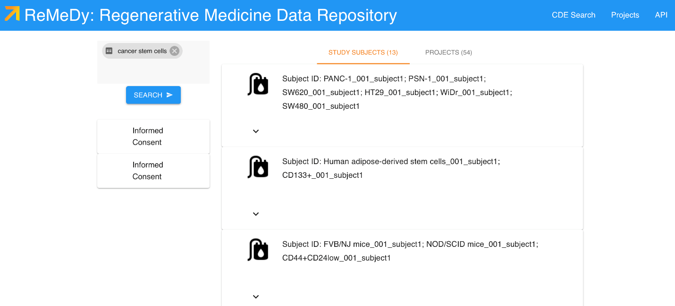
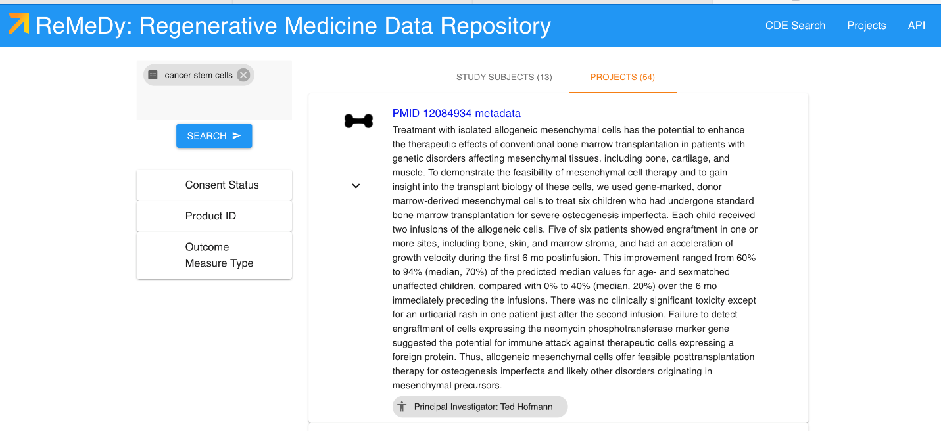
ReMeDy CSCs Data Repository Display

Slide 7
Methods
Database architecture and web interface
Signature Commons platform
BD2K-LINCS DCIC effort
API functionality
JSON format, ingested using a Python script
Literature search, abstraction process and data collection
- 52 published CSC projects

Slide 8
Results: Study Type

Slide 9
Results: Location of the Research Project

Slide 10
Results: Cancer Type

Slide 11
Discussion
Cancer medicine requires the creation of a flexible and agile repository for cancer stem cell data aggregation, storage, visualization, and sharing
ReMeDy platform and the multi-modular CDE framework for CSCs for 52 publicly available and PubMed indexed projects
ReMeDy is an organized repository, which captures CSCs research project information in a standardized format, provides effortless visualization and search functions
ReMeDy promotes accessibility to CSCs projects to facilitate data sharing and collaboration, allowing for standardized cross-discipline and cross-studies comparison

Slide 12
Future Plans and Conclusions
Future aims for the project include increasing the database size to include all published stem cell trials and develop additional data visualization tools to improve usability
Plans for increasing the ReMeDy database size include promoting a crowdsourcing functionality of the platform and developing natural language processing (NLP) functionalities
This effort to include establishing and expanding an automated pipeline for uploading the CDE templates
Advantages of crowdsourcing are ensuring that the knowledge base for CSCs stays current
A. Elghafari, J. Finkelstein, “Automated Identification of Common Disease-Specific Outcomes for Comparative Effectiveness Research Using ClinicalTrials.gov: Algorithm Development and Validation Study,” JMIR Med Inform, vol. 9, no. 2, 2021.
A. Elghafari, J. Finkelstein, “Introducing an Ontology-Driven Pipeline for the Identification of Common Data Elements,” Stud Health Technol Inform, vol. 272, pp. 379-382, 2020

Slide 13
Thank You for Listening!
Questions?
Irena.Parvanova@mountsinai.org

