Slide 1
Introducing a platform for integrating and sharing stem cell research data
Kirill Borziak, Irena Parvanova, and Joseph Finkelstein
Icahn School of Medicine at Mount Sinai, New York, New York, USA

Slide 2
ReMeDy architecture
z
ReMeDy is an implementation of Signature Commons, a BD2K-LINCS platform implemented through Docker and designed to store and search diverse metadata in an agile and flexible manner.
ReMeDy is composed of six packages: proxy, ui, schema, metadata-api, controller, data-api
The ReMeDy platform uses a relational database for data storage. The leveraged data technology alongside a properly implemented schema for data storage provides strong data conformity to the FAIR guidelines (Findable, Accessible, Interoperable, and Reusable).
PostgreSQL
DB
ui
schema
proxy
metadata-api

Slide 3
Multi-modular CDE Framework
General Information
PI Information
Study Subject
Project
Regulatory
Compliance
Animal Models
Project Design
Source/Donor
Research
Systems
Manufacturing / Production
CDE
Modules
In-vitro System
External Assay
Critical Process
Parameters
Critical Quality Attributes
Outcomes / Findings
In-depth Product Characterization
Primary Outcomes
Secondary
Outcomes
Experimental
Findings
Investigator Initiated Product Analysis
IDCCH Assays

Slide 4
ReMeDy data organization
Resource:
Master container for each published stem cell project
Contains libraries
Validator:
Quality control file
Used to verify formatting and requirements of JSON files, prior to ingestion
Allows for integration of ontology information
Applicable to resources, libraries and signatures
Library:
Container for project CDEs, e.g. Project, Manufacturing / Production, Outcomes Modules
Contains signatures
Schema:
Visualization control file
Defines how the data is presented in the search results
Applicable to resources, libraries and signatures
Signature:
Represents individual/ grouped Research System data
Contains information for patients, animal models, and in vitro cell lines

Slide 5
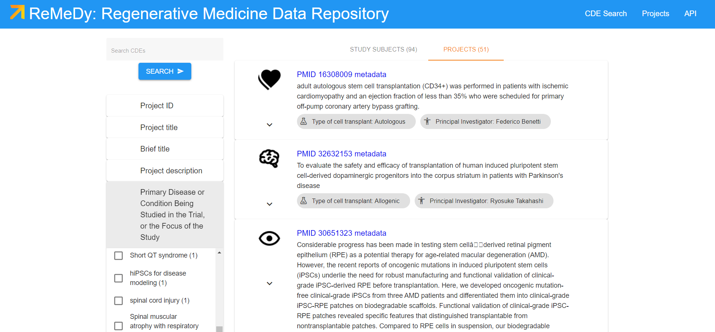
ReMeDy functionality
The API is annotated using Swagger 2.0 JSON implementation, and all RESTful endpoints return structured JSON.

Slide 6
ReMeDy feasibility testing
To test the feasibility of the ReMeDy platform to successfully store data from iPSC projects, we abstracted CDEs from 51 published clinical and pre-clinical iPSC based studies.
The studies selection was randomized across PubMed indexed research, with the aim of obtaining a diverse set of research across time, research location, and research type.
Abstraction was performed by trained personnel with experience in stem cell research.
A total of 51 iPSC resources were created, along with 94 research subject records.
On average, 70 CDEs per iPSC study were abstracted out of a total of 820 CDEs in the multi-modular framework.

Slide 7
Distribution of iPSC projects in ReMeDy

Slide 8
Distribution of iPSC projects in ReMeDy

Slide 9
Distribution of iPSC projects in ReMeDy

Slide 10
Thank you for your attention
https://remedy.mssm.edu/

