Slide 1
Comparative Analysis of Public Data Sets to Identify Stemness Markers that Differentiate Liver Cancer Stem Cells
Kirill Borziak and Joseph Finkelstein
Icahn School of Medicine at Mount Sinai, New York, New York, USA

Slide 2
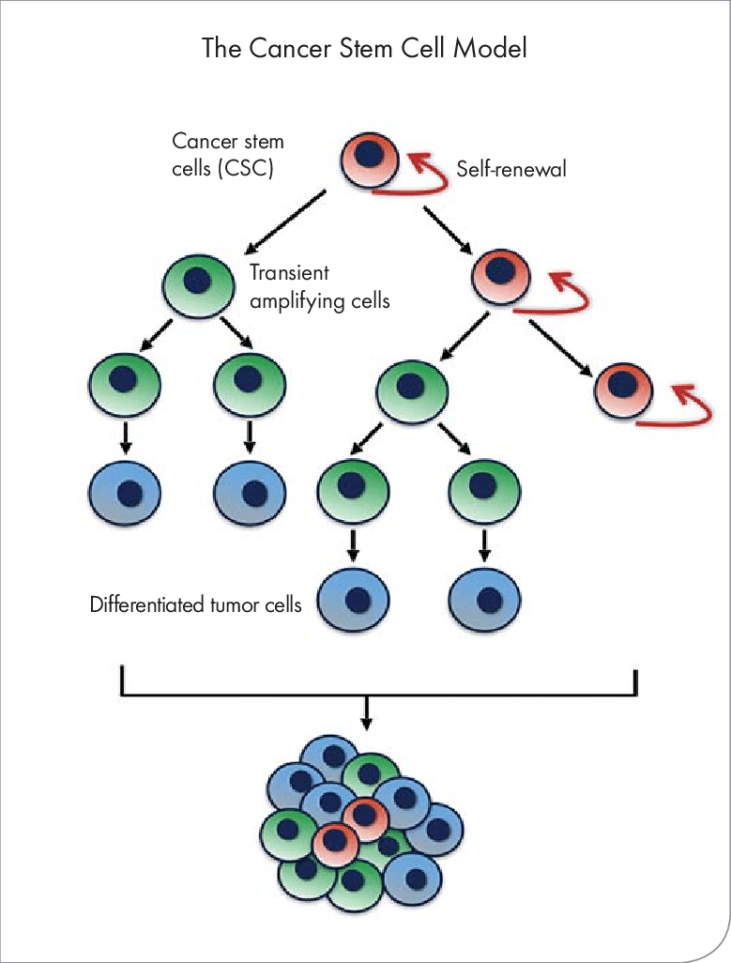
Cancer Stem Cells
Growing evidence has implicated cancer stem cells for causing the therapeutic resistance, tumor recurrence, and metastasis.
Cancer stem cells represent a key target for translational medicine in improving cancer treatment and outcomes.
It is still not entirely understood how cancer stem cells compare to naturally occurring progenitor cells with regards to expression of stemness factors.
Zhang, Kangyi. (2016). A Chemopreventive Nanodiamond Platform for Oral Cancer Treatment. Journal - California Dental Association. 44. 121-127.

Slide 3
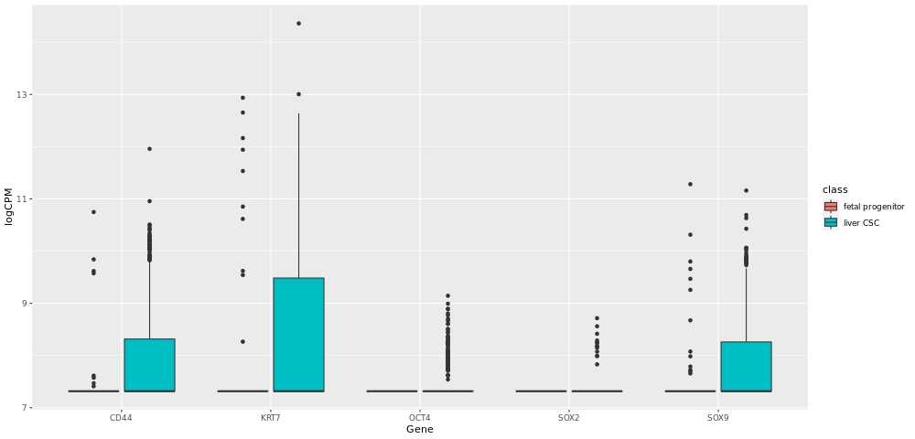
Comparison of liver cancer and liver progenitors
Using previously published single-cell RNA-seq data for liver cancer and fetal and adult healthy liver, we reanalyzed 42684 genes across 10865 samples.
To understand the pluripotency and metastasis potential of cancer stem cells, we compared expression in liver cancer stem cells and fetal liver progenitor cells.
We find significant over-expression of two Yamanaka factors (Oct4 and SOX2) and 3 stemness factors (CD44, KRT7, SOX9) in liver cancer stem cells.
CD44 KRT7 OCT4 SOX2 SOX9
Ma L, Hernandez MO, Zhao Y, et al. Tumor Cell Biodiversity Drives Microenvironmental Reprogramming in Liver Cancer. Cancer Cell. 2019 Oct 14;36(4):418-430.e6.
Segal JM, Kent D, Wesche DJ, et al. Single cell analysis of human foetal liver captures the transcriptional profile of hepatobiliary hybrid progenitors. Nat Commun. 2019 Jul 26;10(1):3350.

Slide 4
Comparison of liver cancer and liver progenitors
GO Term | GO ID | P-value
SRP-dependent cotranslational protein targeting to membrane | GO:0006614 | 5.5E-14
structural constituent of ribosome | GO:0003735 | 4.0E-12
translational initiation | GO:0006413 | 1.9E-11
Gene ontology analysis of the 248 genes at least 5-fold overexpressed in liver cancer stem cells shows enrichment of protein translation and membrane targeting functions.
Our results highlight significant differences in the expression of stemness factors between liver cancer stem cells and fetal progenitor cell types that potentially help explain the self-renewal and treatment resistance phenotypes of cancer stem cells.

Slide 5
Thank you for your attention

