Slide 1
Impact of COVID-19 Pandemic on Use of Telemedicine Services in an Academic Medical Center
Wanting CUI, Joseph FINKELSTEIN
Icahn School of Medicine at Mount Sinai, New York, NY, USA
MIE 2021

Slide 2
Objective
To identify demographic groups of patients who have used telemedicine services before and after the start of the pandemic
To analyze how different demographic groups’ telehealth usage patterns change throughout the course of the pandemic

Slide 3
Introduction
Telemedicine has been gaining popularity in recent years
Some studies had successfully incorporated telemedicine in their treatment and management plans
Some cities and regions had issued ‘stay at home’ orders, since the start of the COVID-19 pandemic
More and more patients are seeking medical advice through telemedicine service
Mount Sinai Health System has been offering secure outpatient video visits integrated into the patient portal of an electronic health record before and during the pandemic

Slide 4
New York State COVID-19 Timeline
Date | Event
March 1, 2020 | First COVID-19 case in New York State
March 14, 2020 | First two COVID-19 deaths in NYS
March 16, 2020 | NYC public schools close
March 17, 2020 | NYC bars and restaurants close, except for delivery
March 22, 2020 | NYS on Pause Program begins, all non-essential workers must stay home
March 28, 2020 | Governor Cuomo halts all nonessential construction sites in NYS
June 8, 2020 | NYC begins Phase 1 reopening
June 22, 2020 | NYC begins phase 2 of reopening
June 24, 2020 | NY, NJ and CT require travelers to self-quarantine for 14 days if traveling from hot spots
July 6, 2020 | U.S. COVID-19 deaths surpass 130,000
July 6, 2020 | NYC begins Phase 3 of reopening, without indoor dining
July 19, 2020 | NYC begins Phase 4 reopening, excluding malls, museums and indoor dining/bars

Slide 5
Method
Extracted from electronic medical records (EMR) at Mount Sinai System
All patients who used telemedicine services
  Telehealth
  Video Visit
  Telephone Visit
  Non Face to Face
  Telemedicine Visit
De-identified Data
Time: 01/2019 – 07/2020

Slide 6
Method
Variables:
  Patients’ demographics (Age, Sex, Race)
  Diagnoses with ICD10 codes
  Medical history with ICD10 codes
Inclusion Criteria:
  18 years and older
  No missing Variables

Slide 7
Method
New Variables:
  Mapped primary diagnoses into body systems
  Age_cat:
    Young Adults: 18 – 39 years old
    Middle-age Adults: 40 – 64 years old
    Older Adults: 65 or older years old
  Pandemic indicator:
    Prior to the start of pandemic (0): services delivered before week 61 (first week of March 2020) of the study
    After the start of pandemic (1): services delivered after week 61 of the study
  Frequency indicator:
    Frequent (1): patients who have used the service at least 3 times and the average interval between services is at least 14 days
    Infrequent (0): None frequent patients

Slide 8
Method
Logistic regression 1:
  Dataset: All patients
  Dependent Variable: Pandemic indicator
  Independent Variable: Age_cat, sex, race
Logistic regression 2:
  Dataset: Patients who use the telemedicine prior to Pandemic
  Dependent Variable: Frequency indicator
  Independent Variable: Age_cat, sex, race
Logistic regression 3:
  Dataset: Patients who use the telemedicine after the start of Pandemic
  Dependent Variable: Frequency indicator
  Independent Variable: Age_cat, sex, race

Slide 9
Result
Number of patients:
  Prior to the pandemic: 2053
  After the pandemic: 127,572
Frequent user:
  Prior to the pandemic: 647 (30%)
  After the pandemic: 10,398 (8%)

Slide 10
Result
Average age:
  Prior to the pandemic: 40.76±14.09
  After the pandemic: 49.67±17.72
Gender:
  Female: 78, 786
  Male: 50,839
Race
  There were significantly less Black telemedicine users (10.92%) compared to Black in person users (around 33%)

Slide 11
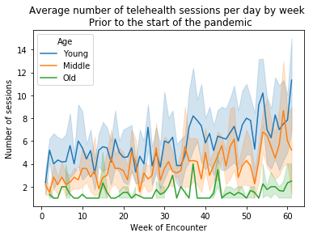
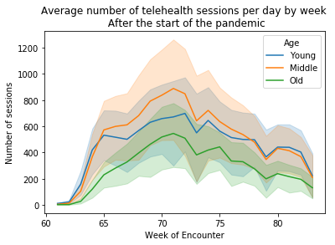
Result

Slide 12
Logistic Regression
Dependent Variable | Pandemic Indicator |  | Frequency Indicator
Subset | All Patients |  | Prior to Pandemic |  | After the start of Pandemic
 | OR | P-Value | OR | P-Value | OR | P-Value
Age Young | 1 |  | 1 |  | 1
Age Middle | 1.58 | 0 | 0.87 | 0.169 | 1.03 | 0.16
Age Old | 5.25 | 0 | 0.86 | 0.434 | 1.14 | 0
Sex Female | 1 |  | 1 |  | 1
Sex Male | 1.14 | 0.004 | 0.88 | 0.191 | 0.89 | 0
Race White | 1 |  | 1 |  | 1
Race Asian | 1.23 | 0.028 | 0.73 | 0.121 | 0.94 | 0.178
Race Others | 1.54 | 0 | 0.77 | 0.015 | 0.81 | 0

Slide 13
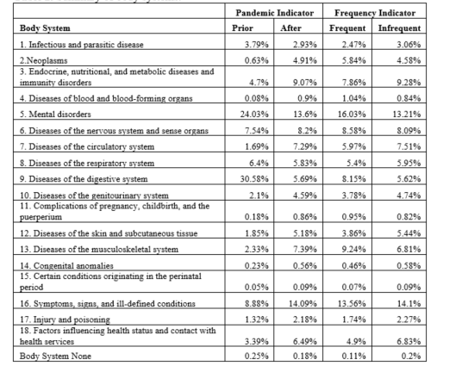
Body System

Slide 14
Discussion
Number of telehealth sessions increased drastically at the start of the pandemic
Significant increase in middle age and older population
Increase in male patients
Increase in non-white patients
Expanded to more medical specialties
Increases in both frequent and non-frequent telehealth users
Patients with mental health problems, digestive track diseases and diseases of the musculoskeletal system were likely to use the telehealth services routinely

Slide 15
Discussion
Results were periodic
More changes in telehealth services
Will continue monitor the trends of telemedicine usage and patients’ retention rate

Slide 16
Conclusion
The COVID-19 pandemic changed the landscape of telehealth services
Demographic shifts occurred in patients seeking telemedicine services
Expansion in medical specialties
Age, race and gender were all important factors to consider creating better telehealth services
Further expansion of telemedicine services to support physical and cognitive rehabilitation, behavioral health, and eldercare is warranted

Slide 17
Thank You!
Contact Information:
Wanting Cui
Email: wanting.cui@mssm.edu

