Slide 1
Identifying Common Outcome Sets in Covid-19
Clinical Trials Using ClinicalTrials.gov
Irena PARVANOVA, PhD and Joseph FINKELSTEIN, MD, PhD
Center for Biomedical and Population Health Informatics
Icahn School of Medicine at Mount Sinai, New York, NY, USA
Irena PARVANOVA, PhD, Center for Biomedical and Population Health Informatics,
Icahn School of Medicine at Mount Sinai, New York, NY, E-mail: Irena.Parvanova@mountsinai.org

Slide 2
COVID-19 Core Outcome Sets (COS)
Core outcome sets (COS) facilitate evidence synthesis, transparency in outcome reporting, and standardization in clinical research.
Publicly available repositories, such as ClinicalTrials.gov (CTG), provide access to clinical trial characteristics, including primary and secondary outcomes, to be analyzed by a broad set of tools.
With growing number of COVID-19 clinical trials, COS development may assist to standardize, aggregate, share, and analyze research results in a harmonized way.

Slide 3
Methods
ClinicalTrials.gov was queried using the following keywords:
- “COVID-19” was typed in the “Other terms” field.
- “United States” was selected in “Country”.
- “NIH” was selected in
“Funder Type”.
https://clinicaltrials.gov/ct2/home

Slide 4
Methods
Our query resulted in the identification of 120 NIH-funded clinical trials.
The analytical data set was used for COVID-19 COS development by evaluating and ranking clinical trials outcomes.
COVID-19 major clinical outcomes were identified based on their representation in at least 1% of the eligible studies.
https://clinicaltrials.gov/ct2/home

Slide 5
Results
COVID-19 COS comprised of 25 major clinical outcomes which were identified and ranked by our query.
Mortality, mental health status, and the presence of COVID-19 antibodies in the blood plasm are the at the top of the ranked list.

Slide 6
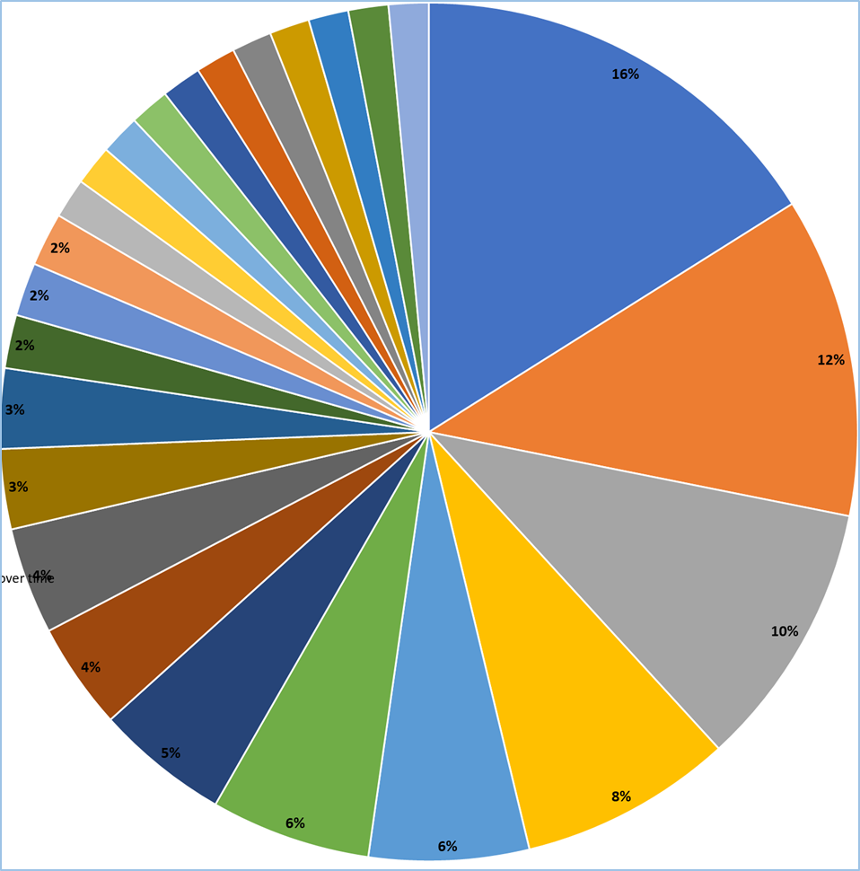
Covid-19
Core Outcome
Sets
# | Outcomes | %
1 | Mortality due to COVID-19 | 16%
2 | Mental health impact of COVID-19 | 12%
3 | Anti-SARS-COV-2 antibodies | 10%
4 | Patients - hospitalization for their COVID-19 disease or die | 8%
5 | SARS-CoV-2 PCR/RT-PCR test results/nasal swabs samples | 6%
6 | Severity of COVID-19 | 6%
7 | Determine CD8 T cells that are responsive to SARS-CoV-2 | 5%
8 | Phone surveys/Questionnaire | 4%
9 | Not hospitalized and activity scale | 4%
10 | 6 minute walk test distance; monitoring physical activity | 3%
11 | Inflammatory responses of cells in lung and circulation | 3%
12 | Collection of convalescent plasma | 2%
13 | Frequency and grade of adverse events (AEs) | 2%
14 | Time of recovery/Recovered patients | 2%
15 | Anti-SARS-COV-2 antibodies overtime | 1.5%
16 | Time to improvement in oxygenation/Hospitalized on oxygen | 1.5%
17 | Percentage of participants with immunity to COVID-19 vaccines over time | 1.5%
18 | Physical symptoms | 1.5%
19 | Reward imbalance/Bullimia nevrosa during COVID-19 pandemic | 1.5%
20 | Diagnostic test sensitivity | 1.5%
21 | Hospitalization for cardiovascular/pulmonary events | 1.5%
22 | Clinical outcomes for cancer patients during COVID-19 pandemic | 1.5%
23 | Change in weight/Change in HbA1C | 1.5%
24 | Women/ Postpartum Care | 1.5%
25 | Child's Immunization Status | 1.5%

Slide 7
Conclusion and Future work
Using ClinicalTrials.gov, we analyzed COVID-19-related outcomes in NIH-funded clinical trials.
We concluded that CTG analytics can be instrumental for COVID-19 COS development.
Future analysis should include a broader number of international trials and more granular approach and ontology-driven pipelines for outcome extraction and curation.
In the future, the platform should also include crowdsourcing functionality for engaging multidisciplinary researchers in ranking COS candidates.

Slide 8
Thank You!
Questions?

