Slide 1
Latent COVID-19 Clusters in Patients with Chronic Respiratory Conditions
Wanting Cui¹, MA, Manuel Cabrera², MD, Joseph Finkelstein¹, MD, PhD
1. Icahn School of Medicine at Mount Sinai, New York, USA
2. Columbia University Irving Medical center, New York, USA
EFMI STC 2020

Slide 2
Objectives
Unsupervised machine learning has been successfully used in CLRD to identify latent clusters in such conditions as asthma and chronic obstructive pulmonary disease
Cluster analysis allowed to identify subgroups of COVID-19 patients with differing risk factors, comorbidities, and prognosis using electronic health records (EHR)
The goal of this study is to conduct cluster analysis of EHR data of CLRD patients who were tested for presence of severe acute respiratory syndrome coronavirus 2 (SARS-CoV-2)

Slide 3
Dataset
Source: Epic, an electronic health record at Mount Sinai Health System
De-identified data set
Time period: 2020/01 – 2020/04
Sample Size: 2,422 eligible patients
Filter criteria: over 18 years old with CLRD based on presence of ICD-10 codes in the range of J40 – J47
Variables: age, sex, race, ethnicity, comorbidity index, COVID19 positive, ICU status, alive, 18 body systems

Slide 4
Methods
Chronicity, Body Systems and Comorbidity Index:
Derived from patient histories based on ICD-10 codes
Factor Analysis for Mixed Data (FAMD):
PCA (Principle Component Analysis) on numeric values and MCA (Multiple Correspondence Analysis) on categorical values
Reduced multi-collinearity issues between variables and achieved dimension reduction

Slide 5
Methods
K-means:
Experimented with 2 clusters to 18 clusters
Calculated the Within Cluster Sum of Squares (WCSS)
Plotted WCSS against the number of clusters
Used the elbow method to determine optimal number of clusters
Subsets:
All CLRD patients
CLRD patients who tested positive for SARS-CoV-2

Slide 6
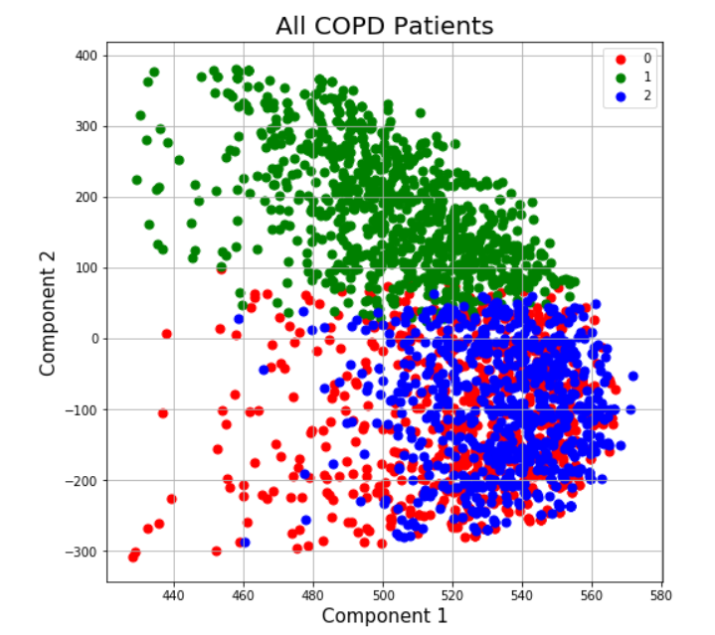
Results – All Patients
Sample Size: 2,328 patients
Positive: 1,029 patients
Negative: 1,299 patients
3 clusters were found

Slide 7
Results – All Patients
 | Cluster 0 | Cluster 1 | Cluster 2
Count | 691 | 881 | 756
Alive | 76.70% | 93.42% | 97.62%
On Ventilator | 8.39% | 3.41% | 1.59%
COVID19 Pos | 99.42% | 38.37% | 0.53%
ICU | 16.35% | 3.97% | 0.40%
HOSPITAL | 60.35% | 34.17% | 30.03%
Comorbidity Index
mean | 5.30 | 2.74 | 5.14
std | 3.03 | 2.08 | 3.53
ICU Length
mean | 1.14 | 0.24 | 0.02
std | 3.63 | 1.80 | 0.32

Slide 8
Results – All Patients
 | Cluster 0 | Cluster 1 | Cluster 2
Age
mean | 65.99 | 52.47 | 60.25
std | 15.62 | 19.15 | 16.87
Sex
Female | 59.91% | 55.16% | 67.72%
Male | 40.09% | 44.84% | 32.28%
Race
Asian | 4.05% | 3.29% | 3.57%
Black | 30.25% | 27.47% | 27.91%
Other | 45.59% | 39.95% | 39.02%
White | 20.12% | 29.28% | 29.50%

Slide 9
Results – All Patients
Body System | Cluster 0 | Cluster 1 | Cluster 2
1. Infectious and parasitic disease | 92.33% | 42.34% | 65.87%
3. Endocrine, nutritional, and metabolic diseases and immunity disorders | 95.22% | 41.20% | 91.67%
7. Diseases of the circulatory system | 89.00% | 37.46% | 83.73%

Slide 10
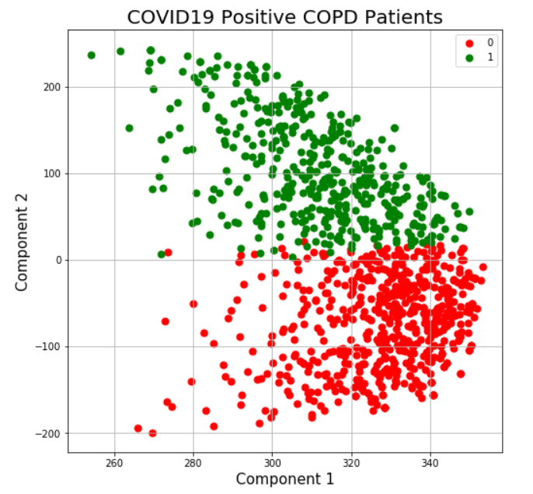
Results – COVID-19 Positive Patients
Sample Size: 1,029 patients
Hospitalized: 528
Not Hospitalized: 501
2 clusters were found

Slide 11
Results – COVID-19 Positive Patients
 | Cluster 0 | Cluster 1
Count | 583 | 446
Alive | 78.73% | 82.74%
On Ventilator | 7.89% | 6.95%
ICU | 16.47% | 10.99%
HOSPITAL | 61.06% | 38.57%
Comorbidity Index
mean | 5.41 | 3.39
std | 3.10 | 2.27
ICU Length
mean | 1.13 | 0.74
std | 3.51 | 3.25

Slide 12
Results – COVID-19 Positive Patients
 | Cluster 0 | Cluster 1
Age
mean | 65.78 | 58.85
std | 15.72 | 18.62
Sex
Female | 62.95% | 48.88%
Male | 37.05% | 51.12%
Race
Asian | 3.60% | 4.71%
Black | 31.56% | 22.65%
Other | 45.11% | 45.07%
White | 19.73% | 27.58%

Slide 13
Results – COVID-19 Positive Patients
Body System | Cluster 0 | Cluster 1
3. Endocrine, nutritional, and metabolic diseases and immunity disorders | 95.71% | 57.85%
6. Diseases of the nervous system and sense organs | 90.22% | 37.89%
9. Diseases of the digestive system | 83.88% | 23.09%
10. Diseases of the genitourinary system | 81.99% | 38.34%
13. Diseases of the musculoskeletal system | 91.77% | 37.44%

Slide 14
Conclusion
Around 44% of CLRD patients tested positive for COVID-19, which was similar to the statistic of all patients (45%) at Mount Sinai Health System
Patients who had COVID-19 had a 23% death rate, compared to the 2% death rate in the non COVID-19 cluster
Patients with immunity disorders or diseases of the circulatory system were more likely to be subjected to the illness
Age and comorbidities were crucial factors
Cluster analysis provided initial insights of COVID-19 subgroups and risk factors in patients with CLRD. This methodology could be applied in the future towards similar studies

Slide 15
Thank You!
Contact Information:
Wanting Cui
Email: wanting.cui@mssm.edu

