Slide 1
Fitbit Accuracy Depends on Activity Pace and Placement Location
Chenhao Wei, Daniel Robins, Joseph Finkelstein
Center for Biomedical and Population Health Informatics
Icahn School of Medicine at Mount Sinai, NY
ICIMTH 07/03/2020

Slide 2
Study Object and Background
Introduction
Wearable fitness trackers are an increasingly popular consumer item, but lack of evidence that demonstrates how these sensors have been tested and validated.
Prior studies have demonstrated significant variability of step counts using pedometer functions from multiple manufacturers.
Measurements may be influenced by health status of the wearer, gait, speed of movement, indoor/outdoor walking, and presence of stairs, among many other conditions.

Slide 3
Study Object and Background
Study Object
This study is designed to investigate how step count results from Fitbit fitness trackers may vary depending on:
Their locations on the body.
The speed of movement as participants climb and descend stairs.

Slide 4
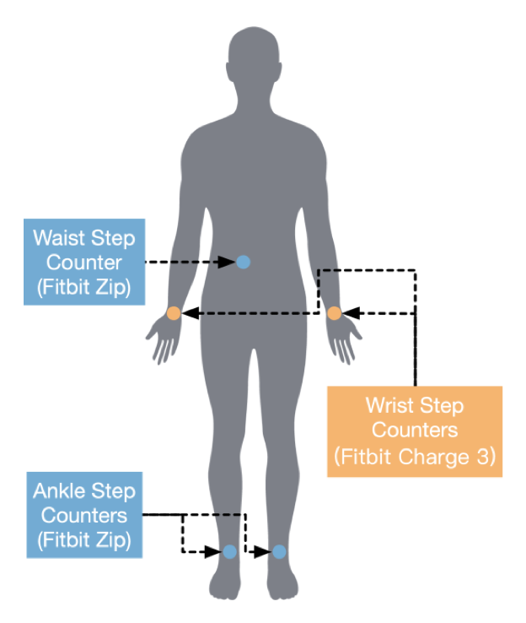
Method
Study Design
Nine healthy adults (7 males, 2 females, all right-handed).
Perform 3 phases of stair climbing:
Slow
Medium
Fast
Concurrently wear 5 Fitbit activity trackers.
Analyze the data with one-way ANOVA analysis method.

Slide 5
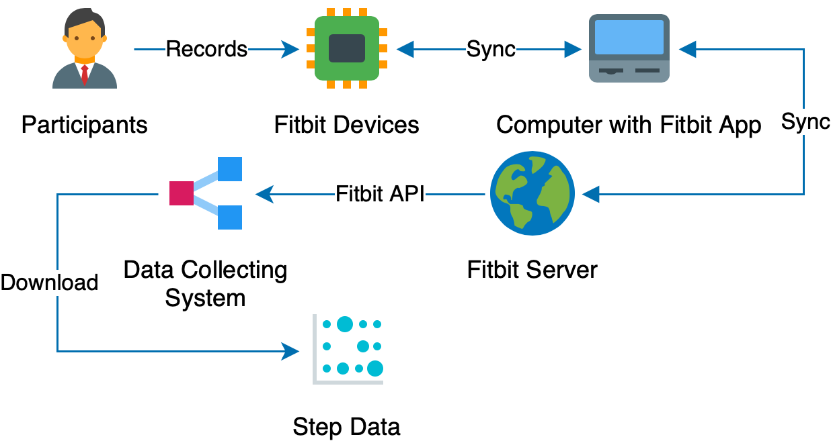
Method
System Design

Slide 6
Results
Pace | Variance | SD | MAX-MIN | % Mean
Slow | 1770.9±3307.5 | 27.6±27.1 | 73.0±63.1 | 44.5±61.0
Medium | 25.9±24.5 | 4.0±2.3 | 10.8±5.9 | 8.6±6.3
Fast | 113.1±106.7 | 8.7±4.0 | 23.3±10.5 | 26.2±15.8
Variability of step reporting depending on Fitbit placement and climbing pace (Mean±SD)

Slide 7
Results
Average step counts by tracker location, for each pace.

Slide 8
Discussion
Wearable devices are poorly suited to track step counts for patients with limited mobility, advanced age, or even novices just beginning an exercise regimen.
On these particular activity trackers, step count results for anyone moving at a pace other than ‘medium pace’ may be sub-optimal.
The implications of such extreme variance are amplified further when combining step counts across multiple paces; results from a single session with multiple speeds (e.g. interval training) and/or analyzing results longitudinally across multiple sessions (e.g. tracking progress) should be taken in context.

Slide 9
Discussion
Interestingly, in our population of all right-handed participants, results from ‘Right Wrist’ were frequently lower than the readings acquired from ‘Left Wrist’ and other locations on the body.
This trend is more pronounced at the slow and fast paces.
It is possible that this reflects less arm movement of the ‘main’ arm; this arm is more steady with less shaking, or perhaps the arm and hand are held in a position to grab the handrail and brace in case of a sudden fall.

Slide 10
Discussion
These results highlight the need for transparency and review of the validation studies of wearables’ sensors before their use is considered in a professional context.
Studies of patients with chronic obstructive pulmonary disease and multiple sclerosis suggest that these patients in particular may benefit from decisions informed by wearables’ data. However, there must be a thorough understanding of data quality before appropriate data-driven decisions can be made.

Slide 11
Acknowledgements
This study was supported in part by a grant R61HL143317 from the National Institutes of Health.

